Slide 1

GEO Knowledge Hub to preserve and share EO Applications: Introduction and practice
Visão geral sobre análise de dados
GEO Knowledge Hub team
Date: 11th of September from 14:00 to 16:00 (CET)
Where: EuroGEO Workshop - Online

Slide 2
Agenda
Introduction of EuroGEO and partners
Introduction to the GEO Knowledge Hub
Hands-on presentation of the GEO Knowledge Hub
Best practices for creating Knowledge Packages

Slide 3



GEO Knowledge Hub team
Kalamkas Yessimkhanova
Paola de Salvo
Felipe Carlos
We are not alone! Our team thanks everyone who worked with us, especially Gilberto Camara, Douglas Cripe, Gilberto Queiroz, Florian Franziskakis, Hendrik Baeyens, and the InvenioRDM community
EuroGEO Workshop 2024
GEO Knowledge Hub to preserve and share EO Applications

Slide 4

Material availability
All the materials used during this workshop are available in the following GitHub repository:
geo-knowledge-hub/geo-knowledge-hub-workshop
EuroGEO Workshop 2024
GEO Knowledge Hub to preserve and share EO Applications

Slide 5

Group on Earth Observations (GEO)
GEO is a partnership of more than 110 national governments and in excess of 100 Participating Organizations
EuroGEO Workshop 2024
GEO Knowledge Hub to preserve and share EO Applications

Slide 6
Group on Earth Observations (GEO)
GEO envisions a future where decisions and actions for the benefit of humankind are informed by coordinated, comprehensive and sustained Earth observations
EuroGEO Workshop 2024
GEO Knowledge Hub to preserve and share EO Applications

Slide 7
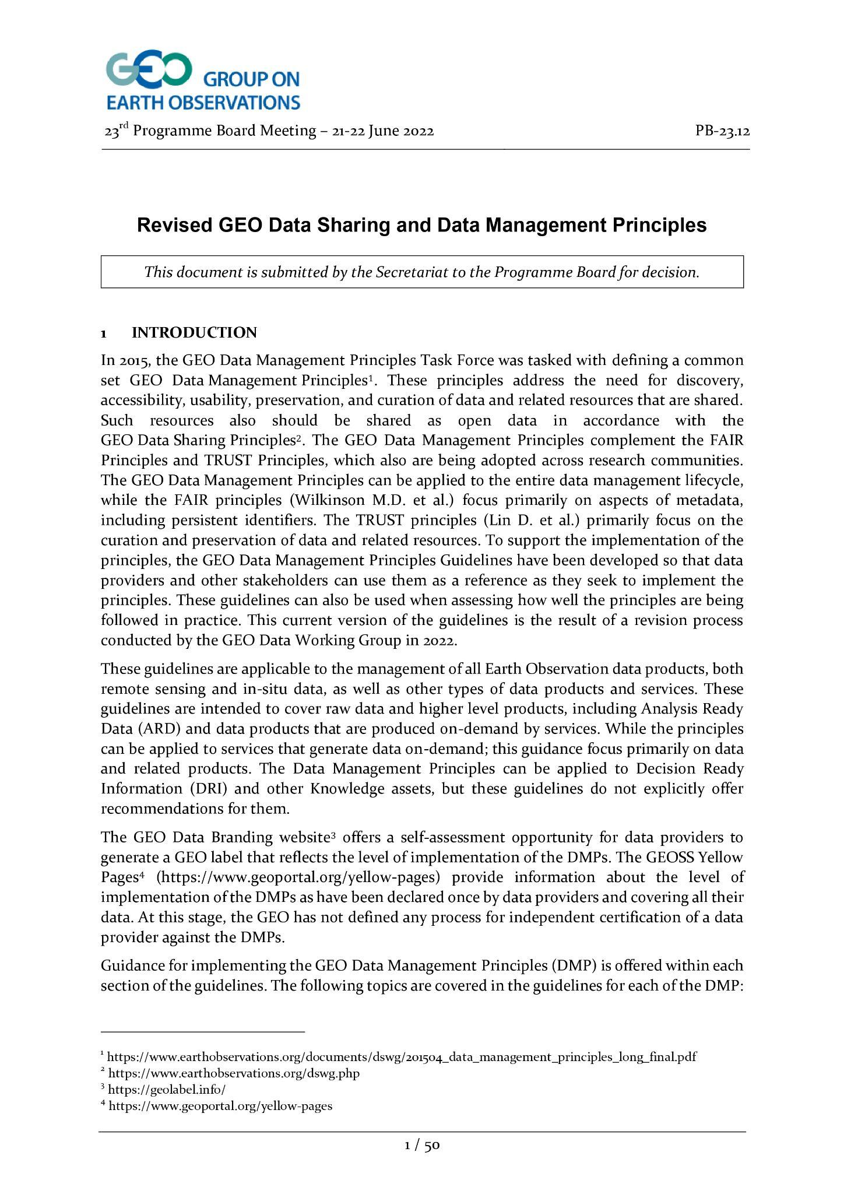
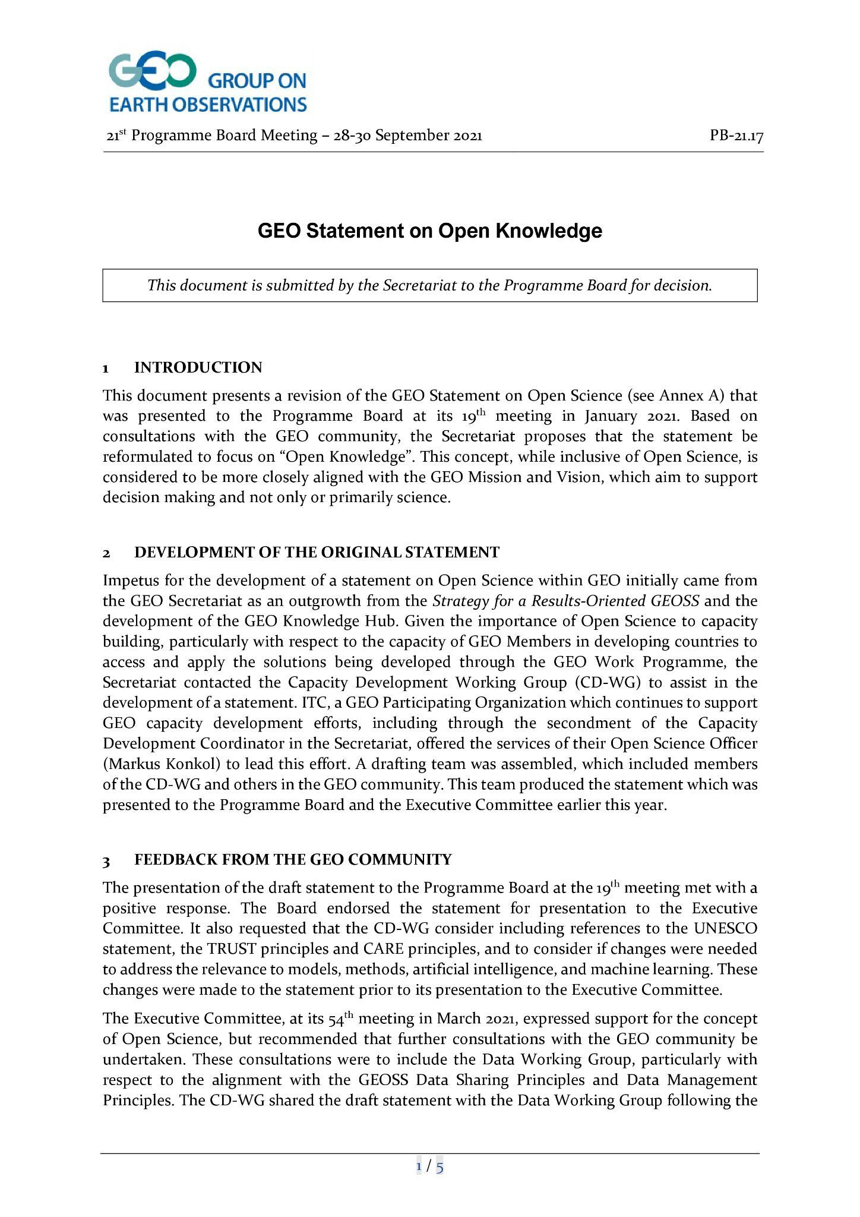
Group on Earth Observations (GEO)
GEO Data Sharing principles
Open Knowledge Statement
EuroGEO Workshop 2024
GEO Knowledge Hub to preserve and share EO Applications

Slide 8

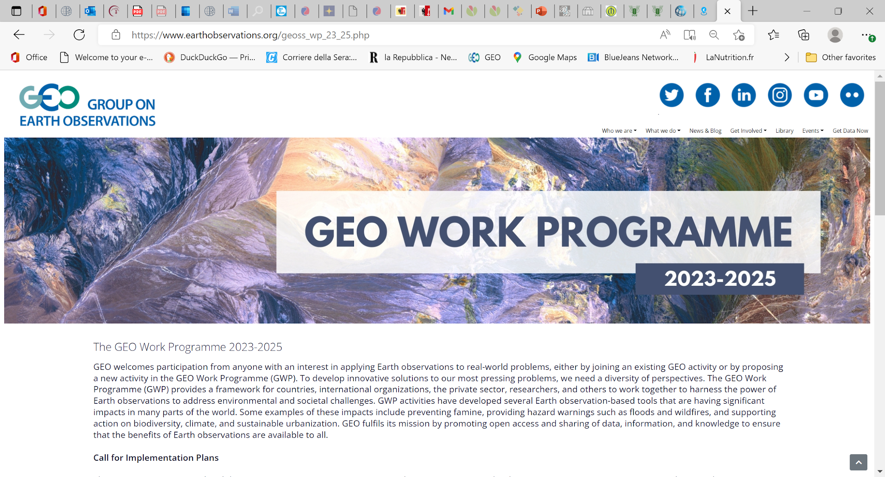
Group on Earth Observations (GEO)
Download the GEO Work Programme 2023-2025 Summary Document, which contains short descriptions of each of the GEO Flagships, Initiatives, Pilot Initiatives and Regional GEOs that comprise the GEO Work Programme.
EuroGEO Workshop 2024
GEO Knowledge Hub to preserve and share EO Applications

Slide 9

Group on Earth Observations (GEO)
EuroGEO Workshop 2024
GEO Knowledge Hub to preserve and share EO Applications

Slide 10
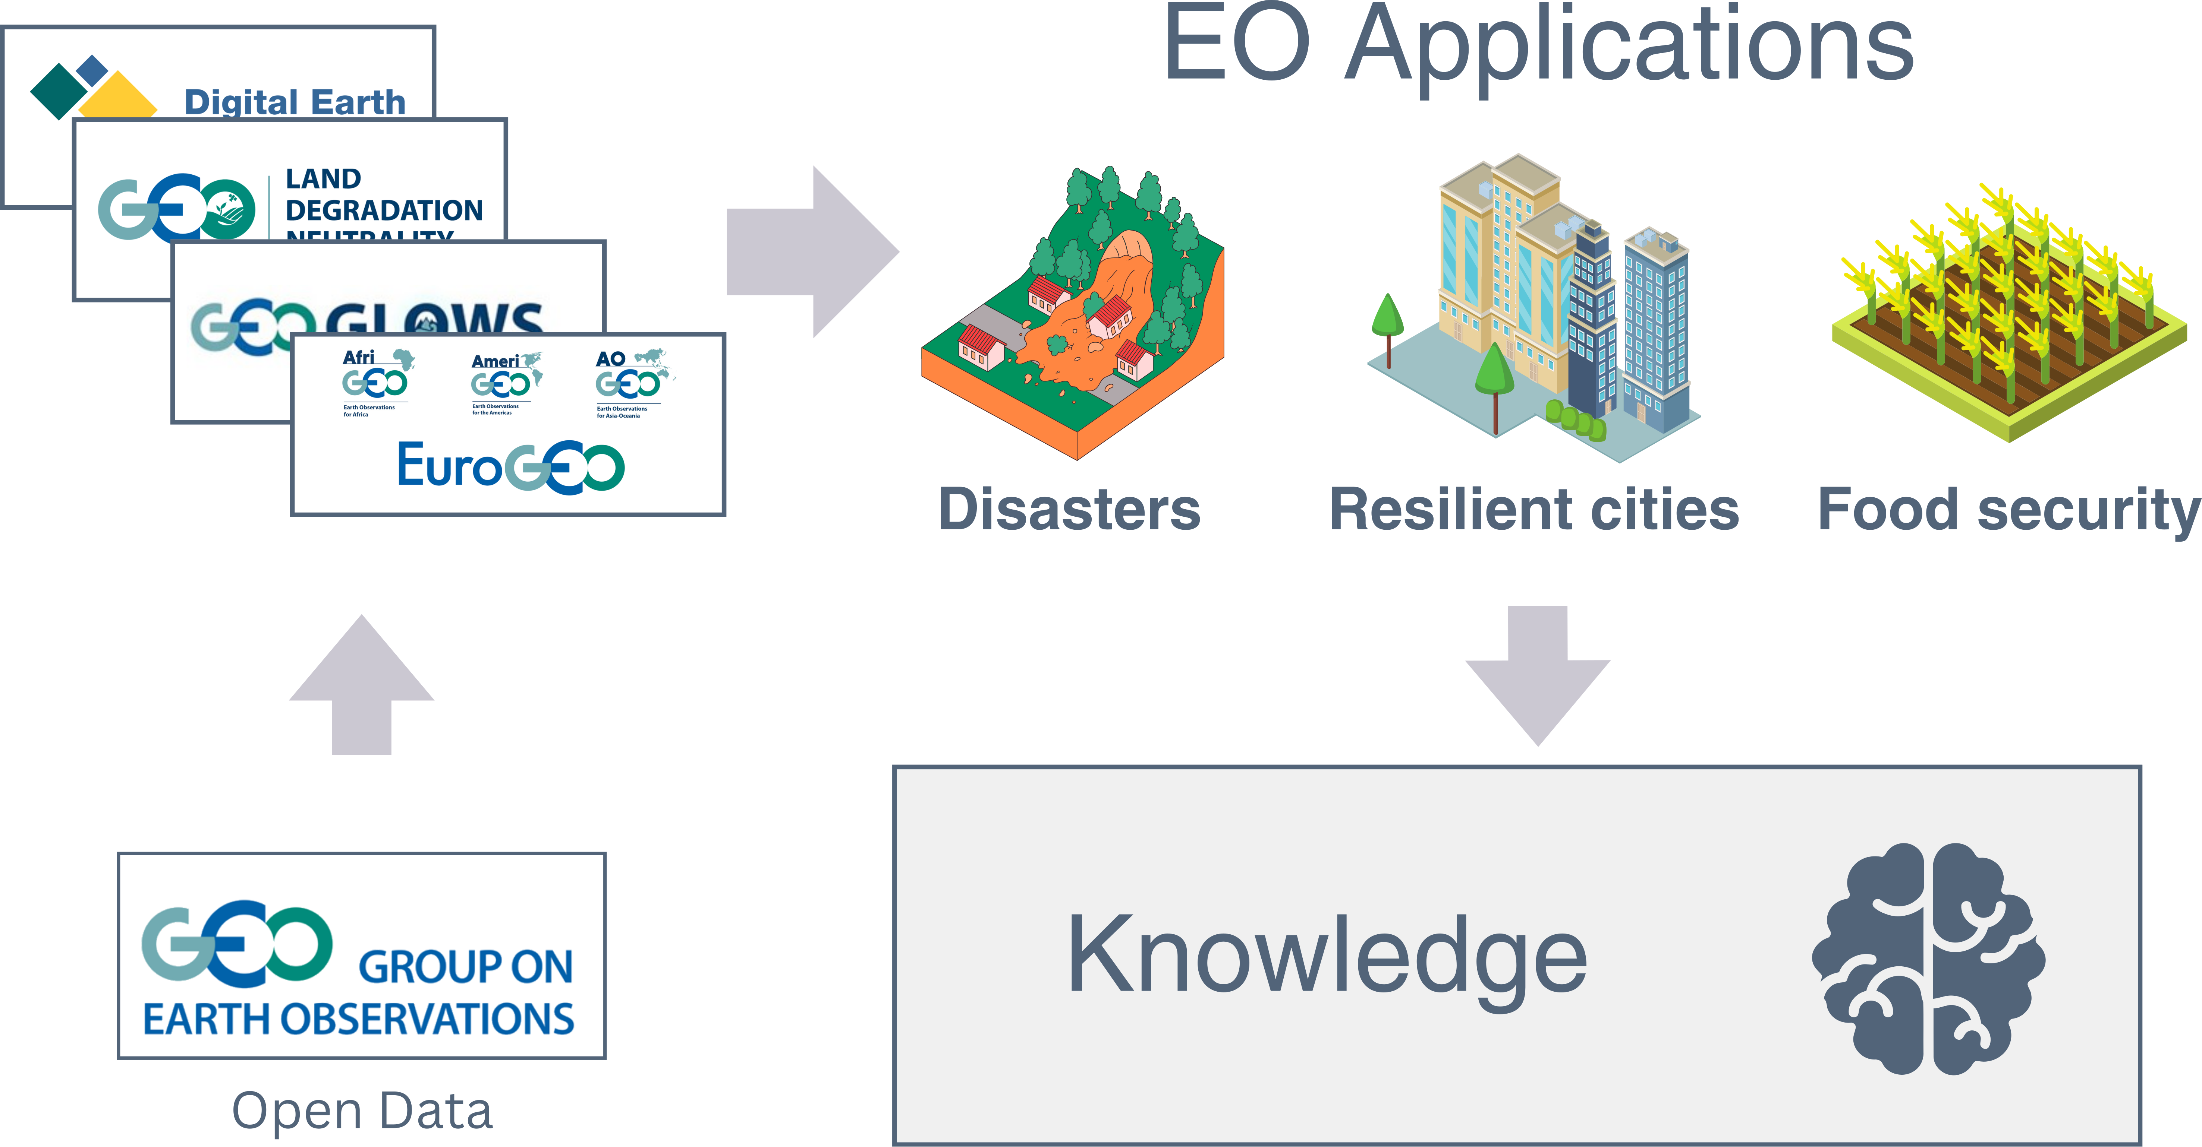
EuroGEO Workshop 2024
GEO Knowledge Hub to preserve and share EO Applications

Slide 11
EuroGEO Workshop 2024
GEO Knowledge Hub to preserve and share EO Applications

Slide 12
GEO holds valuable knowledge and solutions that cannot remain hidden
We have the responsibility and urgency to make those open applications known and used
EuroGEO Workshop 2024
GEO Knowledge Hub to preserve and share EO Applications

Slide 13

EuroGEO Workshop 2024
GEO Knowledge Hub to preserve and share EO Applications

Slide 14
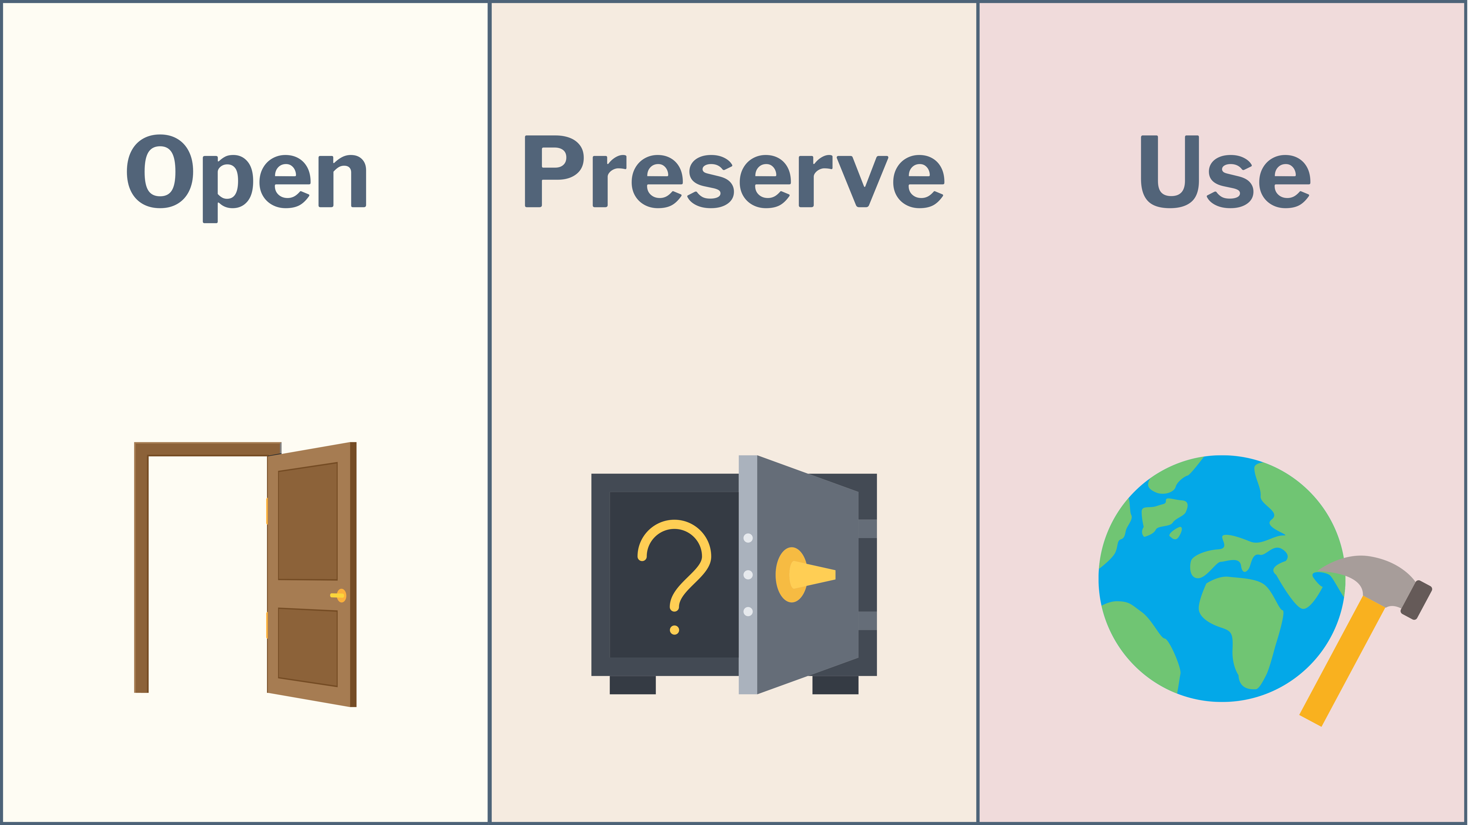
Open EO applications for Food Security – Focus on GEOGLAM Crop Monitor

Slide 15

EuroGEO Workshop 2024
GEO Knowledge Hub to preserve and share EO Applications

Slide 16
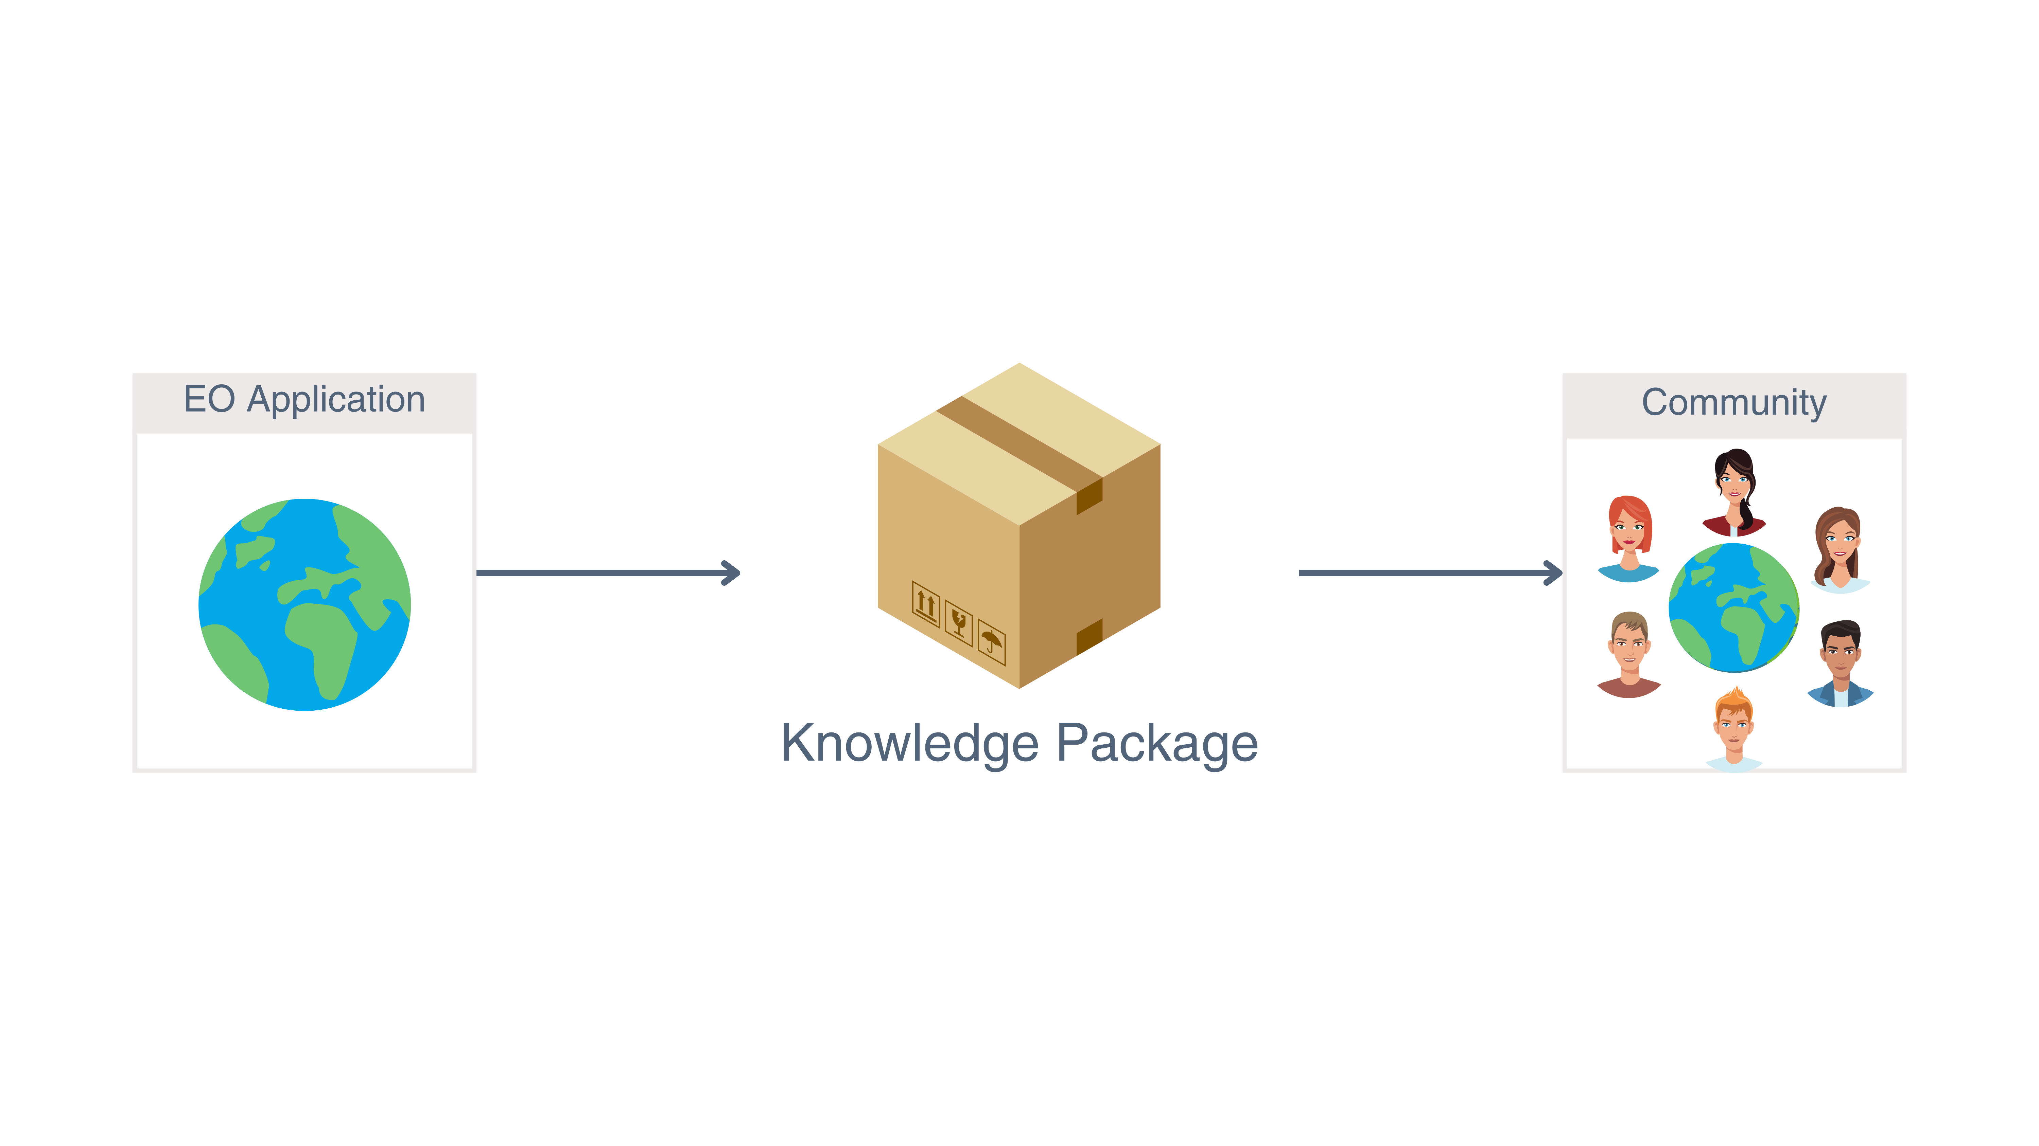
EuroGEO Workshop 2024
GEO Knowledge Hub to preserve and share EO Applications

Slide 17
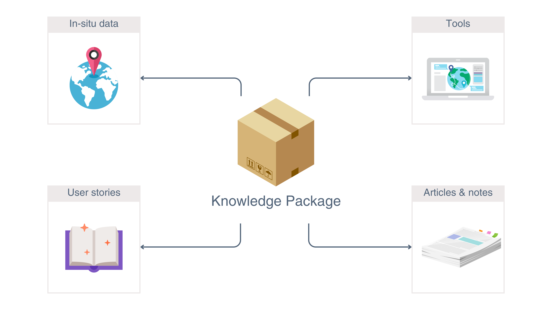
EuroGEO Workshop 2024
GEO Knowledge Hub to preserve and share EO Applications

Slide 18
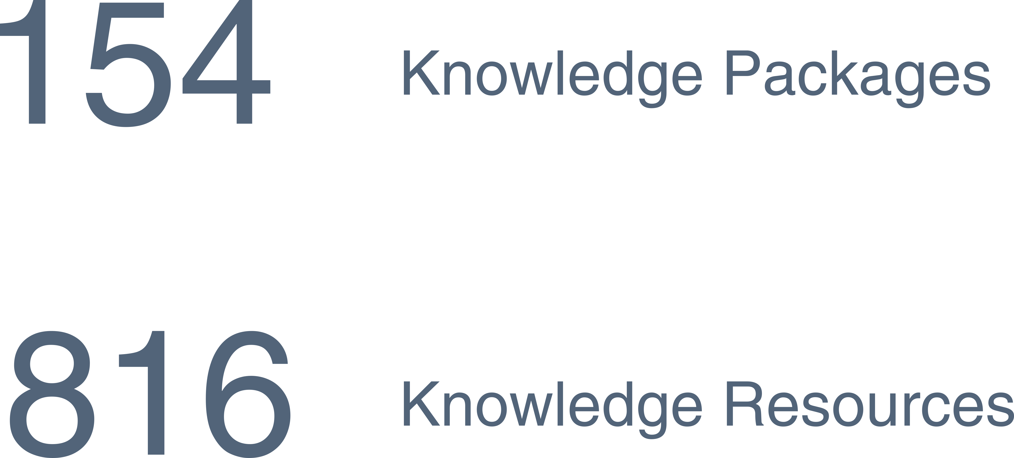
EuroGEO Workshop 2024
GEO Knowledge Hub to preserve and share EO Applications

Slide 19

EuroGEO Workshop 2024
GEO Knowledge Hub to preserve and share EO Applications

Slide 20
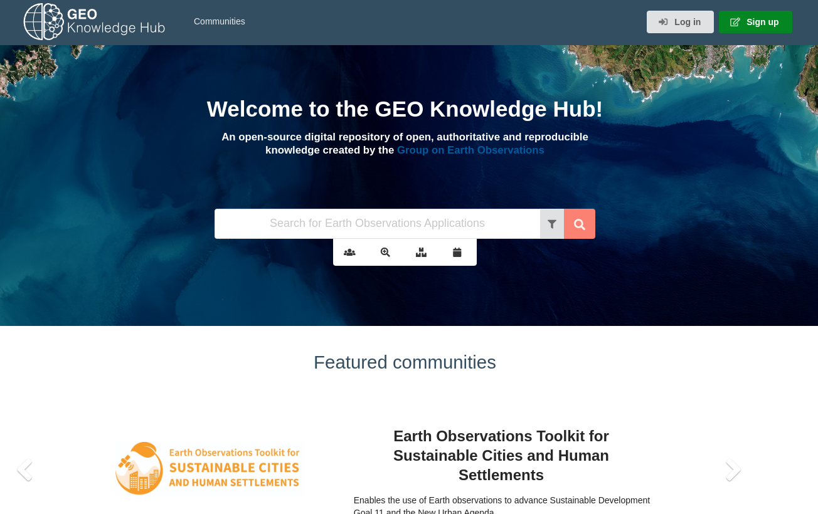
gkhub.earthobservations.org
EuroGEO Workshop 2024
GEO Knowledge Hub to preserve and share EO Applications

Slide 21
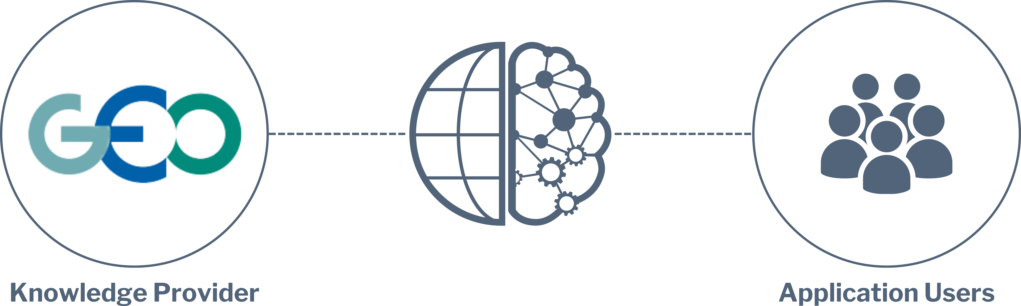
Spreading Knowledge

Slide 22
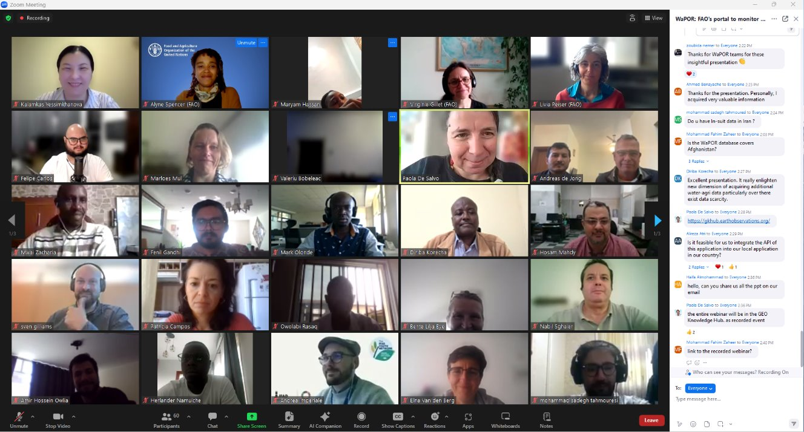
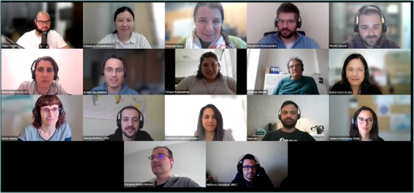
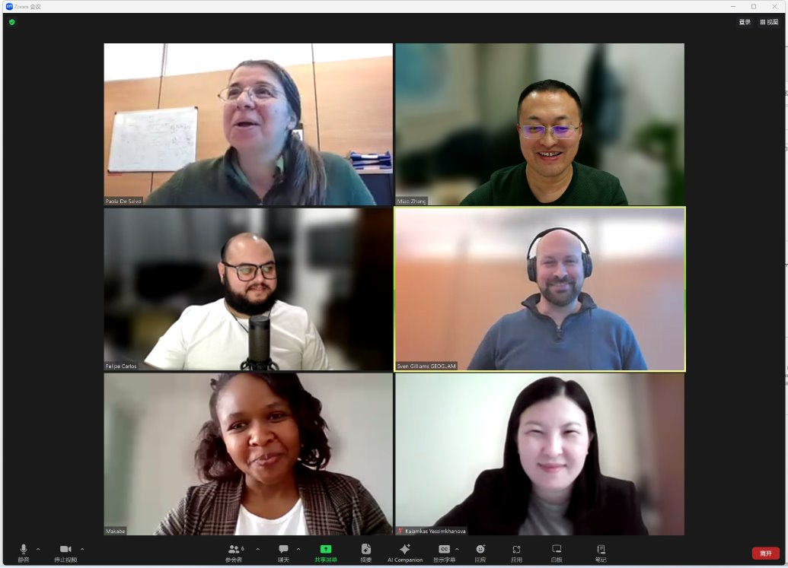
Spreading Knowledge
Organization of webinars to showcase knowledge shared in the GKH
Highly involvement of the Knowledge Providers

Slide 23
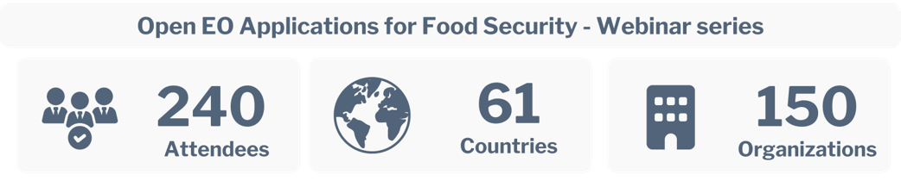
Spreading Knowledge

Slide 24
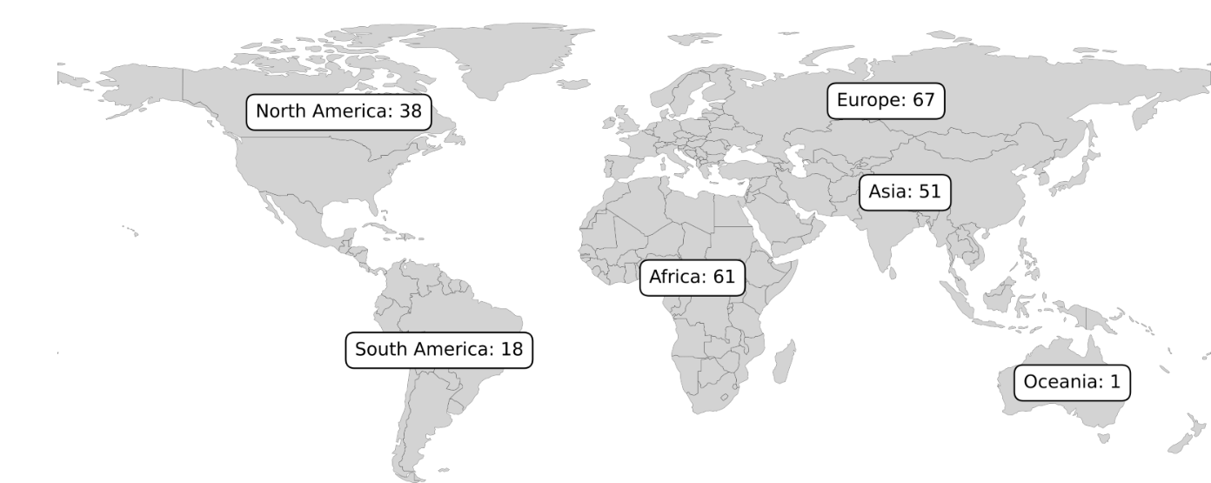
Spreading Knowledge

Slide 25

Spreading Knowledge

Slide 26
Questions
EuroGEO Workshop 2024
GEO Knowledge Hub to preserve and share EO Applications

Slide 27
Hands-on presentation of the GEO Knowledge Hub
EuroGEO Workshop 2024
GEO Knowledge Hub to preserve and share EO Applications

Slide 28
Workshop instance
Practical demonstration
EuroGEO Workshop 2024
GEO Knowledge Hub to preserve and share EO Applications

Slide 29
Creating Knowledge Packages

Slide 30

Creating Knowledge Packages

Slide 31
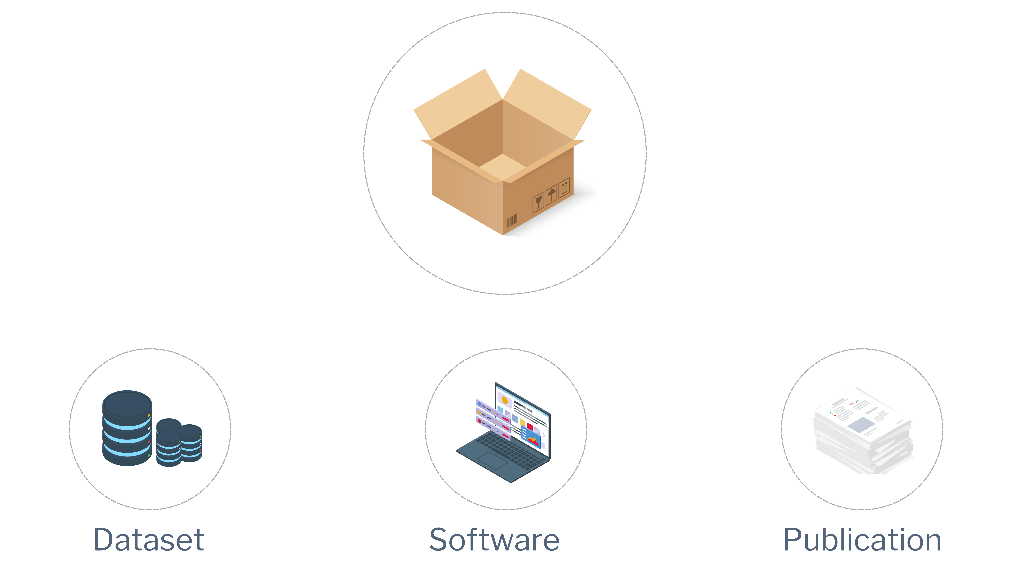
Creating Knowledge Packages

Slide 32
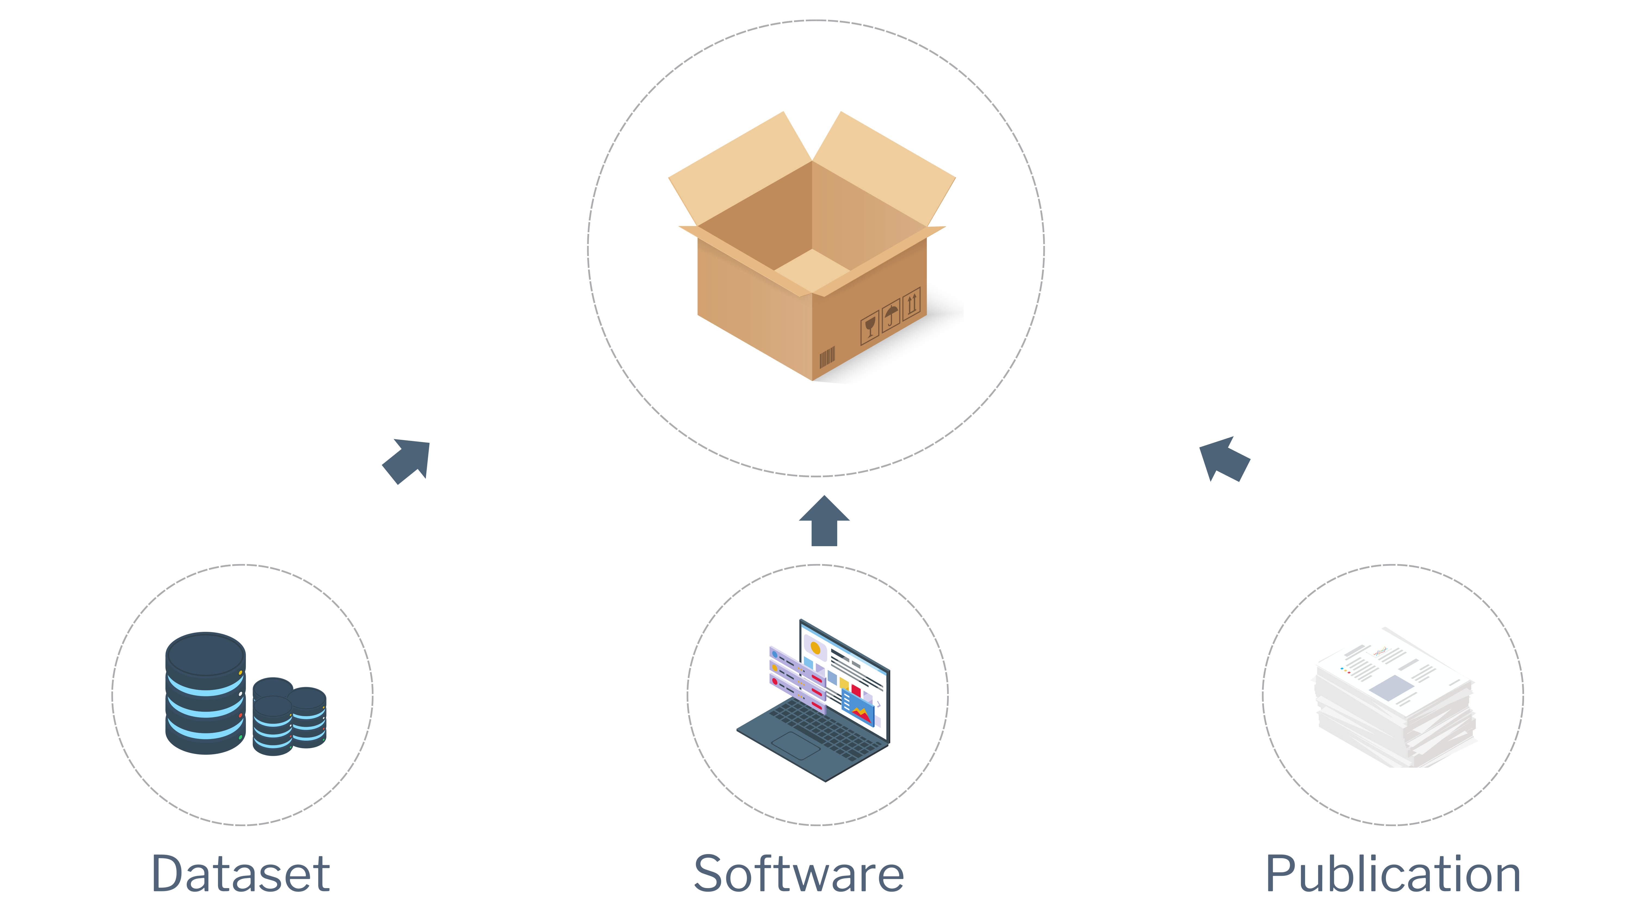
Creating Knowledge Packages

Slide 33
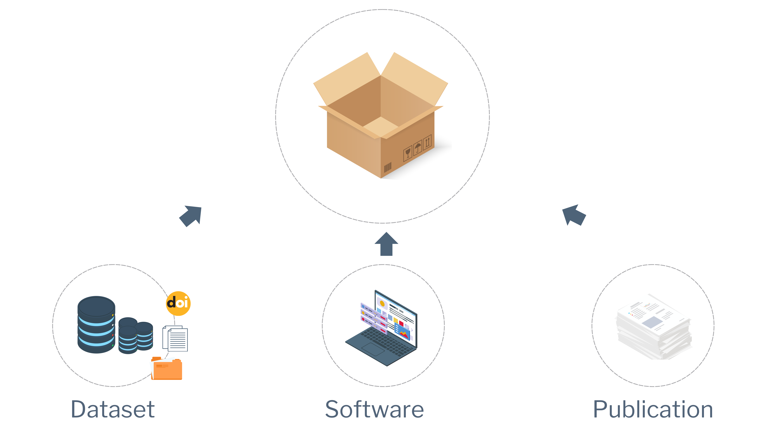
Creating Knowledge Packages

Slide 34
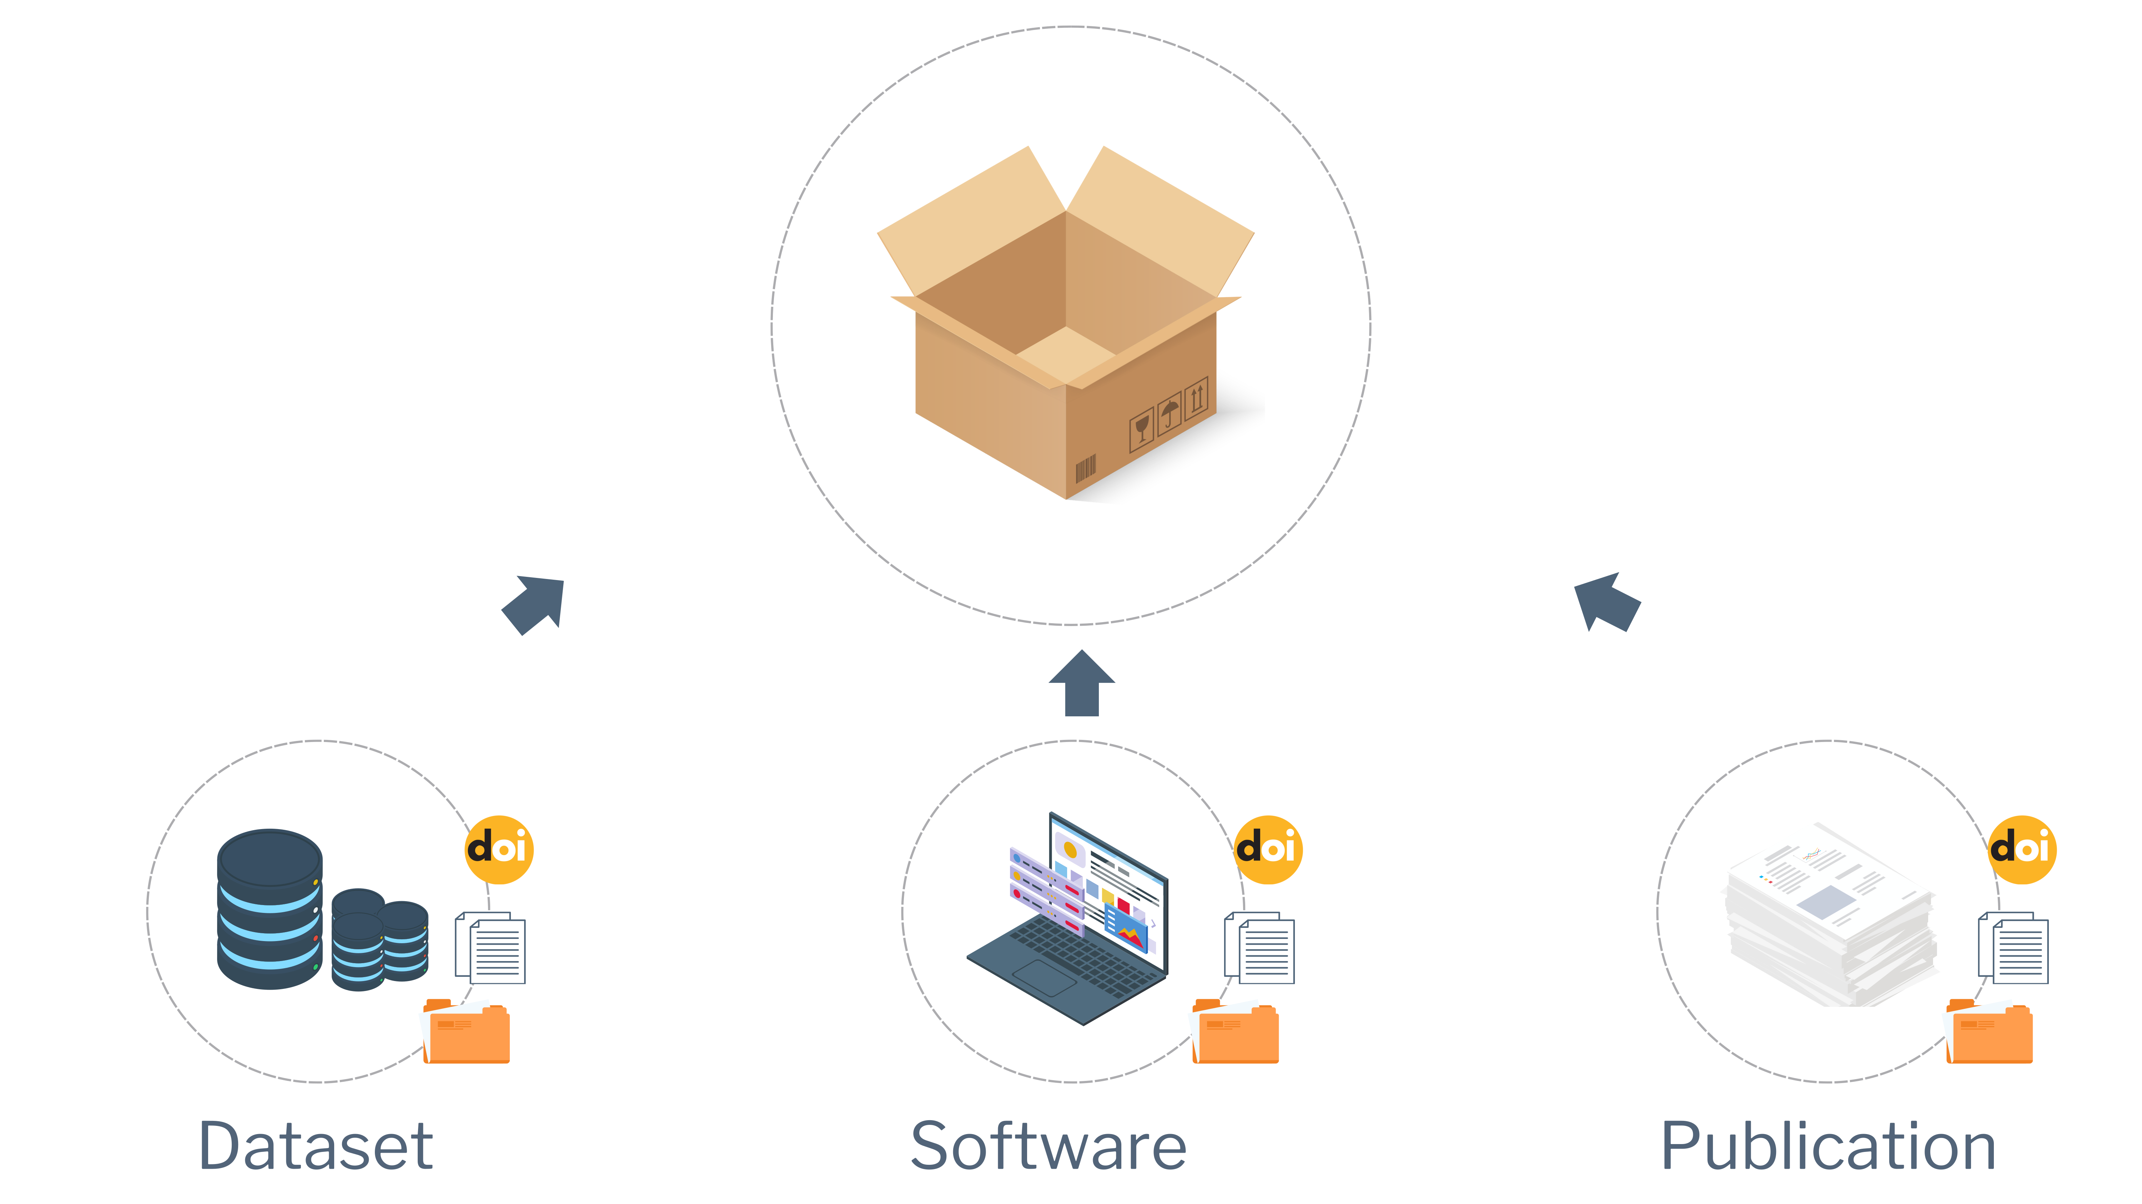
Creating Knowledge Packages

Slide 35
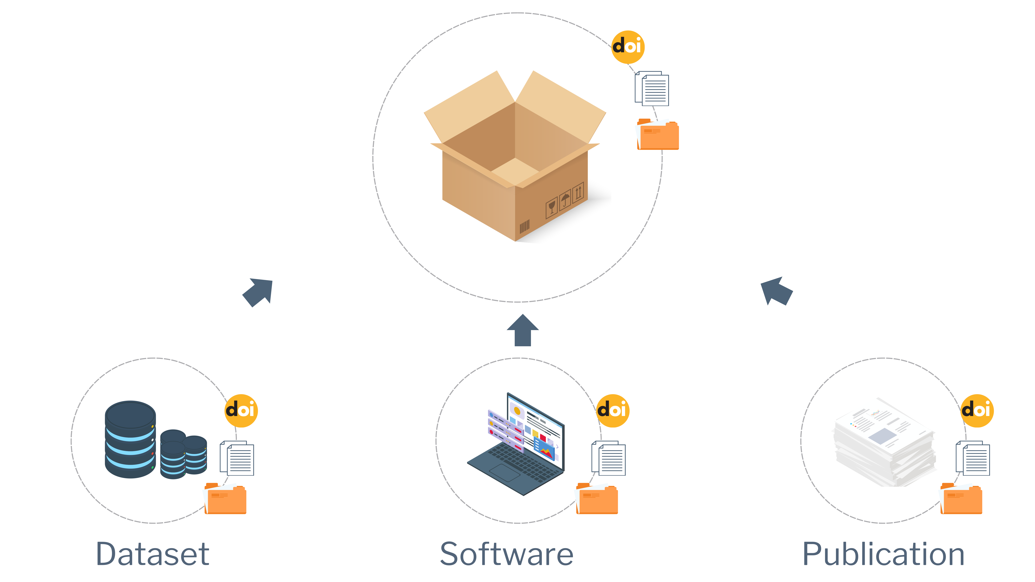
Creating Knowledge Packages

Slide 36
Rest API
EuroGEO Workshop 2024
GEO Knowledge Hub to preserve and share EO Applications

Slide 37

Rest API
EuroGEO Workshop 2024
GEO Knowledge Hub to preserve and share EO Applications

Slide 38
Rest API
Bulk Package Loader
EuroGEO Workshop 2024
GEO Knowledge Hub to preserve and share EO Applications

Slide 39
Rest API
Bulk Package Loader
OGC/CSW Package Loader
(Harvester)
EuroGEO Workshop 2024
GEO Knowledge Hub to preserve and share EO Applications

Slide 40
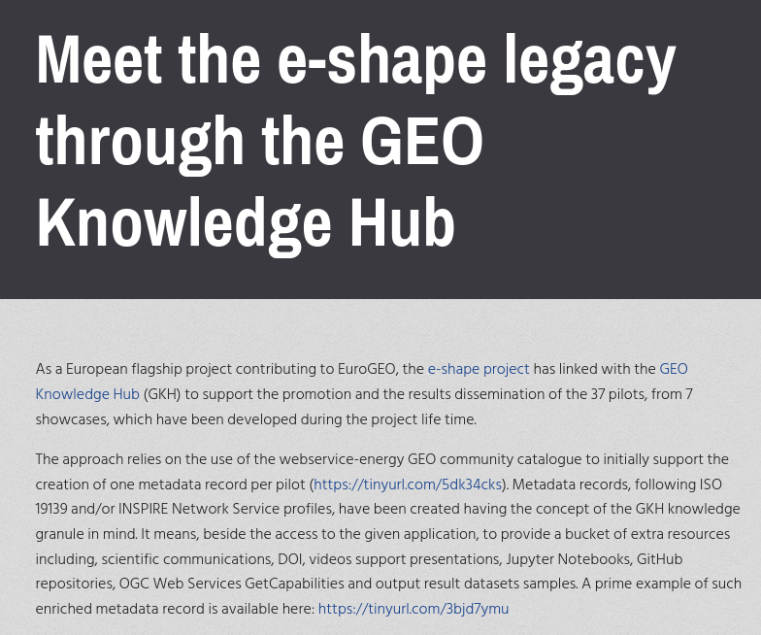
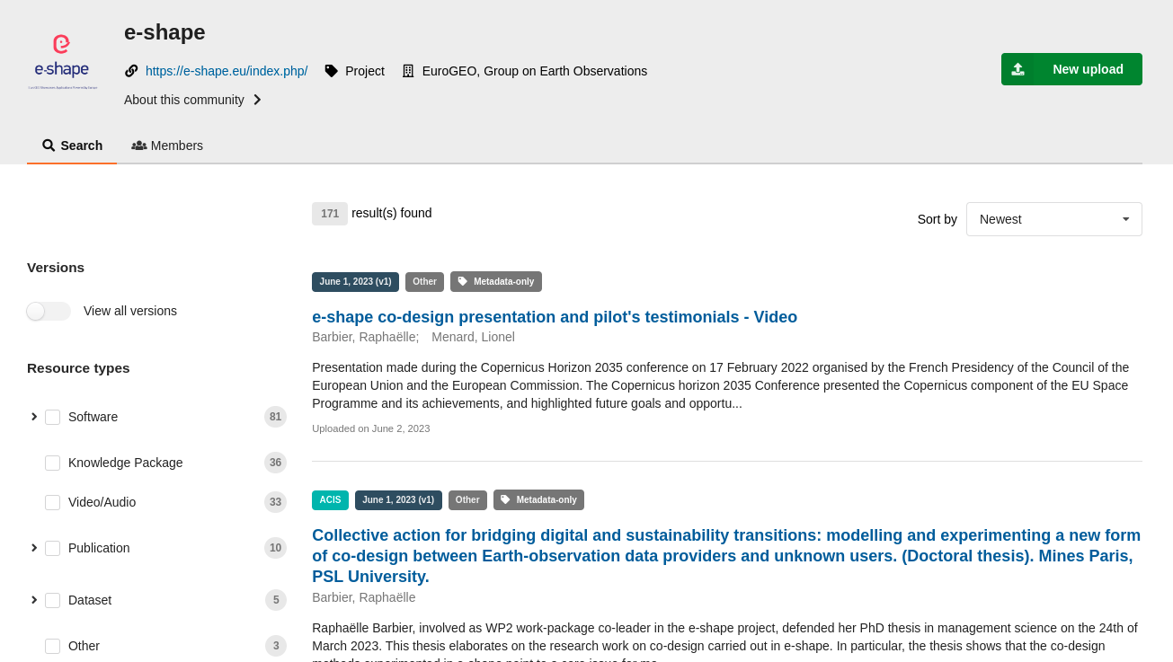
Using the Rest API
tinyurl.com/e-shape-gkh
EuroGEO Workshop 2024
gkhub.earthobservations.org/communities/e-shape

Slide 41
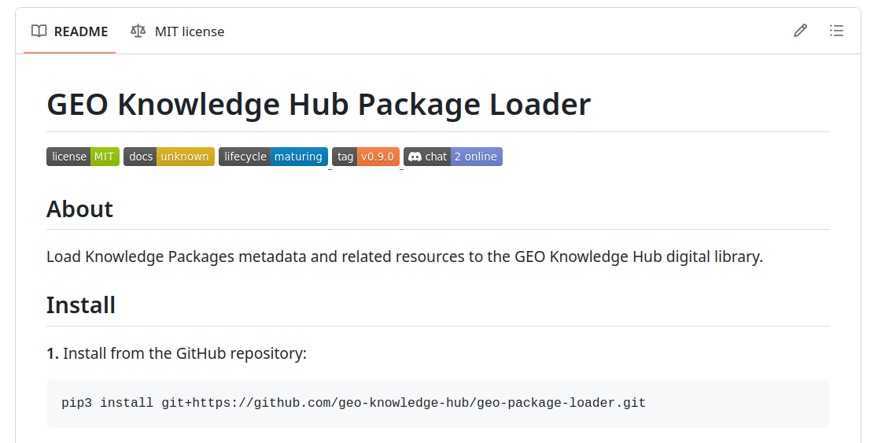
Using the Rest API
github.com/geo-knowledge-hub/geo-package-loader
EuroGEO Workshop 2024
GEO Knowledge Hub to preserve and share EO Applications

Slide 42
Documentation
EuroGEO Workshop 2024
GEO Knowledge Hub to preserve and share EO Applications

Slide 43
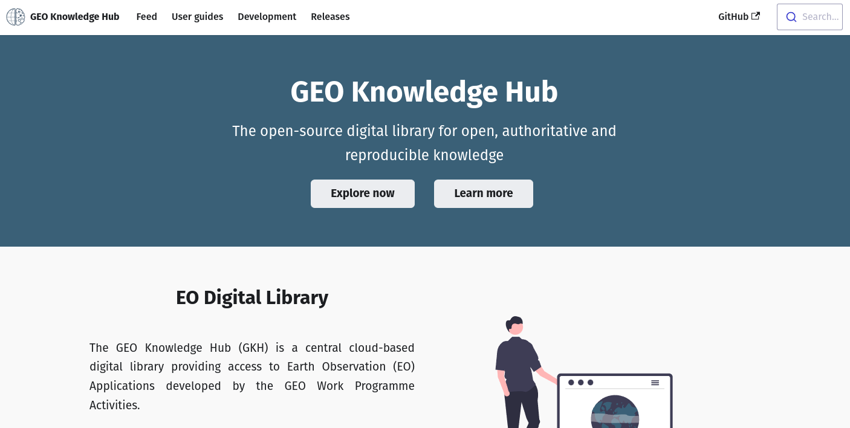
Documentation
gkhub.earthobservations.org/doc
EuroGEO Workshop 2024
GEO Knowledge Hub to preserve and share EO Applications

Slide 44
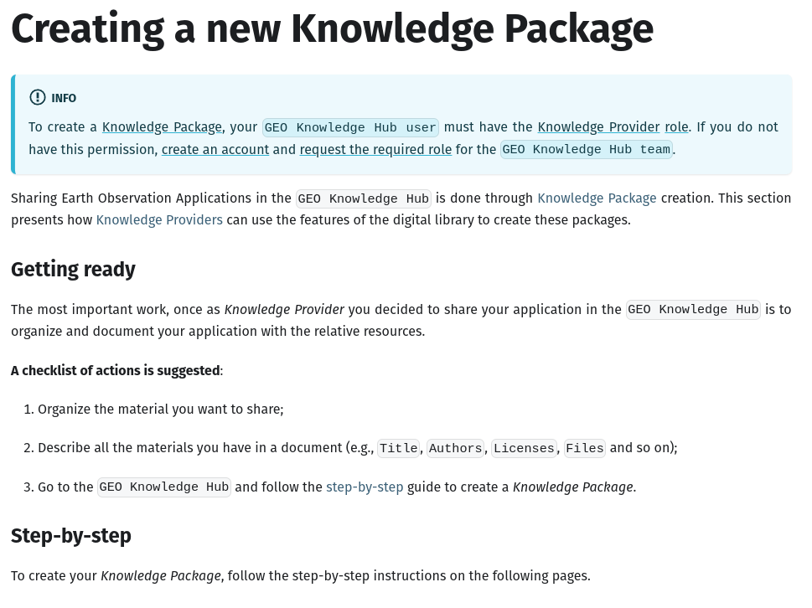
Documentation
gkhub.earthobservations.org/doc
EuroGEO Workshop 2024
GEO Knowledge Hub to preserve and share EO Applications

Slide 45
Best practices for creating Knowledge Packages
EuroGEO Workshop 2024
GEO Knowledge Hub to preserve and share EO Applications

Slide 46

Clear Documentation
EuroGEO Workshop 2024
GEO Knowledge Hub to preserve and share EO Applications

Slide 47

Descriptive Metadata & Data Accessibility
EuroGEO Workshop 2024
GEO Knowledge Hub to preserve and share EO Applications

Slide 48
Metadata
Title
Description
Authors (Creators and contributors)
DOI

Slide 49
Metadata
Title
Date
Focus area and engagement priorities
Description
Geospatial info
GWP
Authors
License
Version
DOI
Related links
Target audience
GEO Data Working Group. (2024). GEO Data Sharing and Data Management Principles. GEO Knowledge Hub.
https://doi.org/10.60566/3p7vv-ykj55

Slide 50

Make publications visible
EuroGEO Workshop 2024
GEO Knowledge Hub to preserve and share EO Applications

Slide 51

Provide access to training materials
EuroGEO Workshop 2024
GEO Knowledge Hub to preserve and share EO Applications

Slide 52

Ensure effortless access to the full range of products
EuroGEO Workshop 2024
GEO Knowledge Hub to preserve and share EO Applications

Slide 53

Providing User Stories
EuroGEO Workshop 2024
GEO Knowledge Hub to preserve and share EO Applications

Slide 54

Licensing
GEO Data Working Group - Law and Policy Subgroup. (2023). Data Licensing Guidance. Geneva, Switzerland: Group on Earth Observations Secretariat.
https://doi.org/10.60566/c3yd5-2s987
EuroGEO Workshop 2024
GEO Knowledge Hub to preserve and share EO Applications

Slide 55

Interact with community
EuroGEO Workshop 2024
GEO Knowledge Hub to preserve and share EO Applications

Slide 56

Think in the long-term
EuroGEO Workshop 2024
GEO Knowledge Hub to preserve and share EO Applications

Slide 57

Always Up-To-Date
Supported by the GKH Link Checker automated tool
EuroGEO Workshop 2024
GEO Knowledge Hub to preserve and share EO Applications

Slide 58
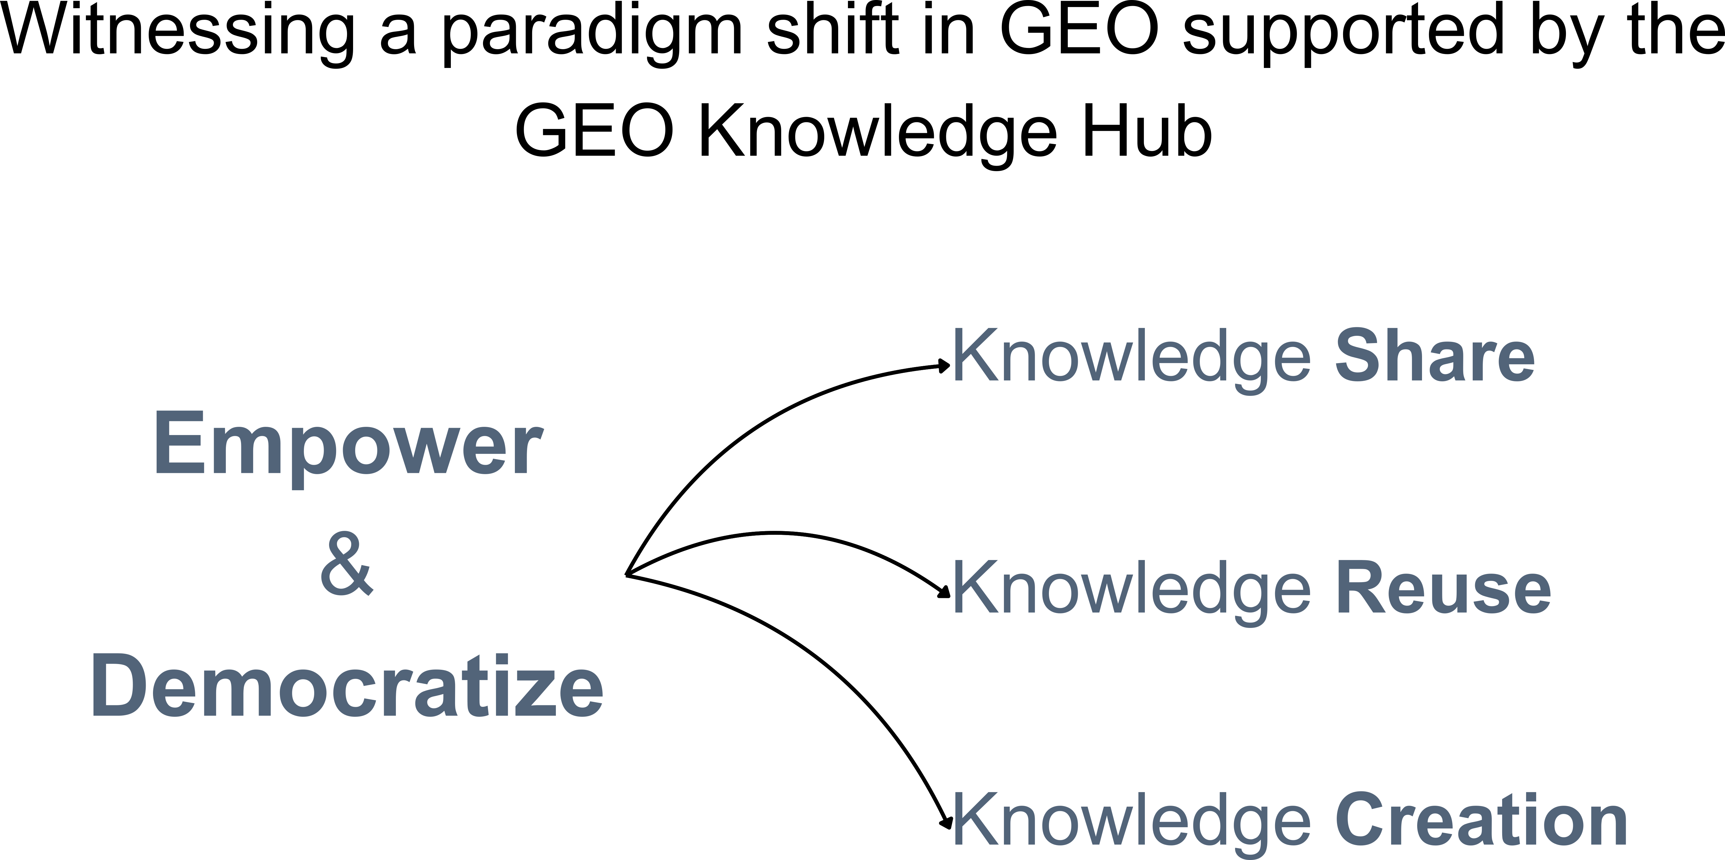

Slide 59

We build with together with the GEO Community
❤️
(1) Community effort
(2) On-demand approach
(3) Let’s go together
56

Slide 60
Thank you
EuroGEO Workshop 2024
GEO Knowledge Hub to preserve and share EO Applications

